Slide 1
Comparing SINGLE & Double Deep-Q Networks for AI Learning to Play GALAGA
By Braeden Stewart
CS 5640

Slide 2
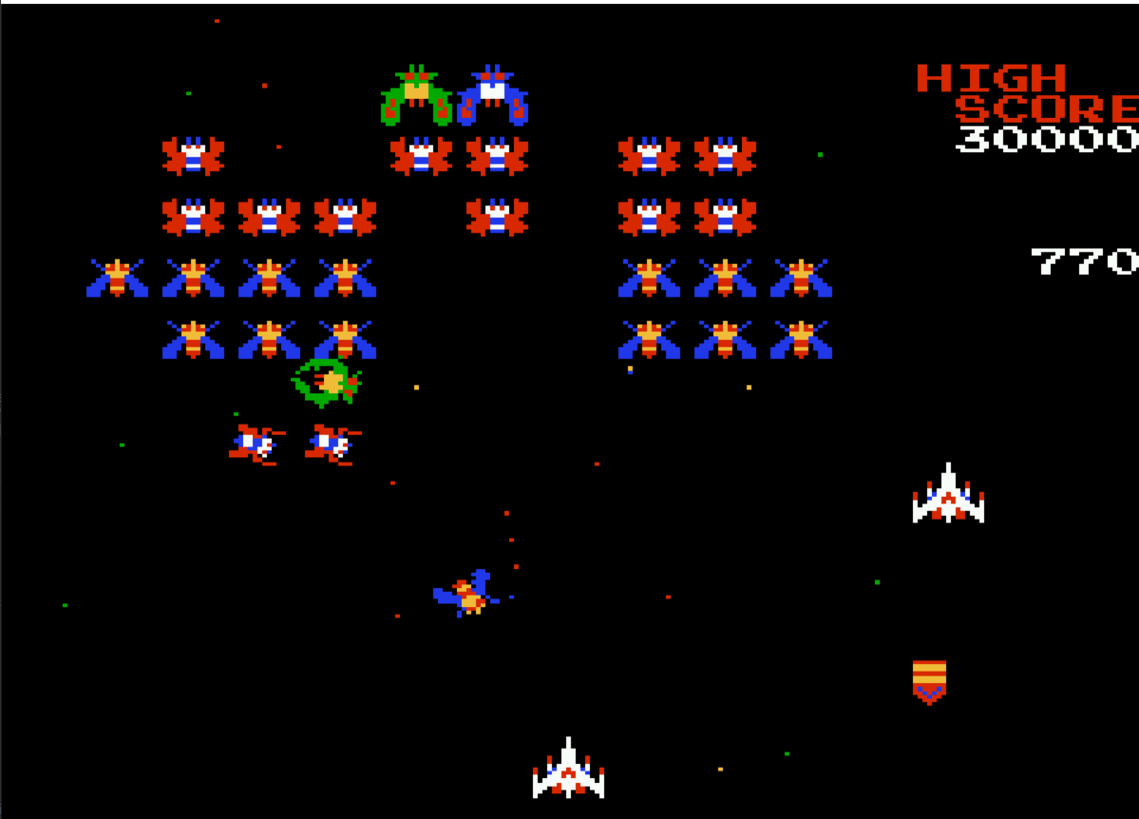
What:
Comparing Neural Network agents to play, and beat Galaga
Why:
Finding a predominant neural network design helps quicken the development of Autonomous Anti-Air emplacements
Beat my mother’s high score
Picture of the video game Galaga, The player controls the ship at the bottom

Slide 3
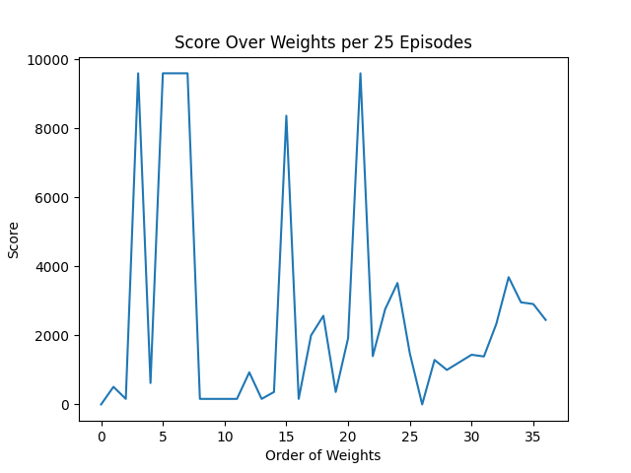
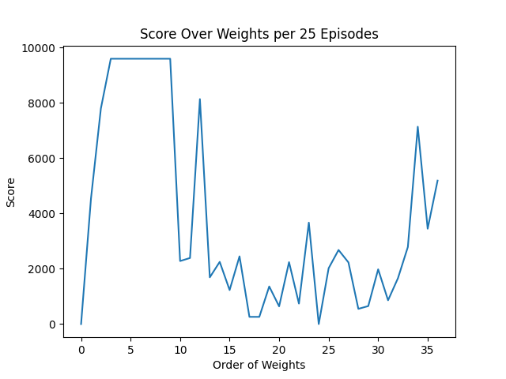
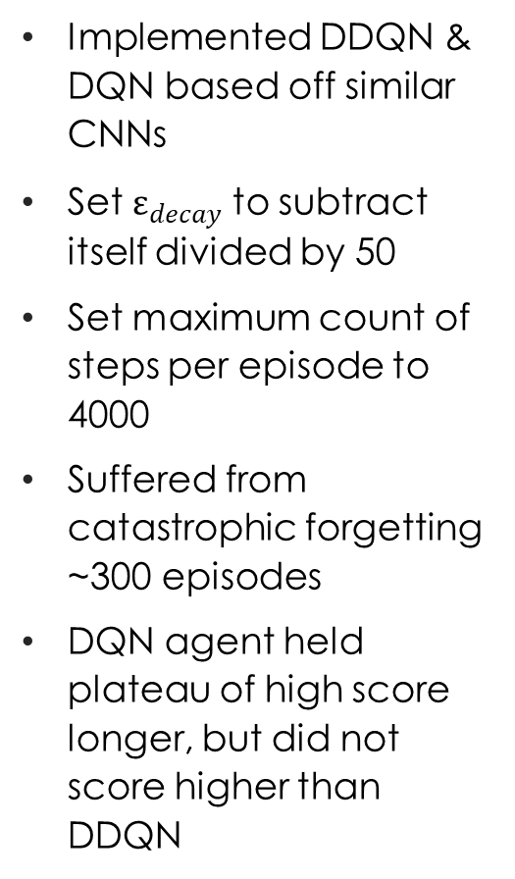
Version 1
Implemented DDQN & DQN based off similar CNNs
Set $ε_{decay}$ to subtract itself divided by 50
Set maximum count of steps per episode to 4000
Suffered from catastrophic forgetting ~300 episodes
DQN agent held plateau of high score longer, but did not score higher than DDQN
DDQN:
DQN:

Slide 4
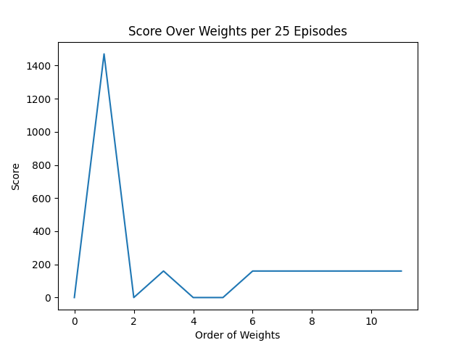
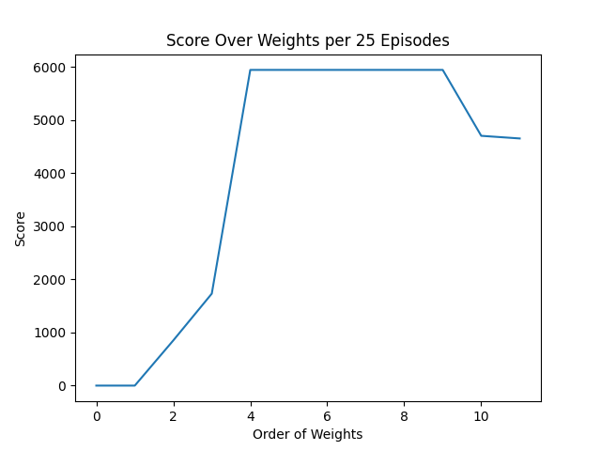
Version 2
Increased exploration time
Kept maximum count of steps per episode at 4000
Observed more consistent high scores from DQN agent
Observed DDQN agent perform abysmally.
Noticed that both agents were unable to play Galaga fully
DDQN:
DQN:

Slide 5
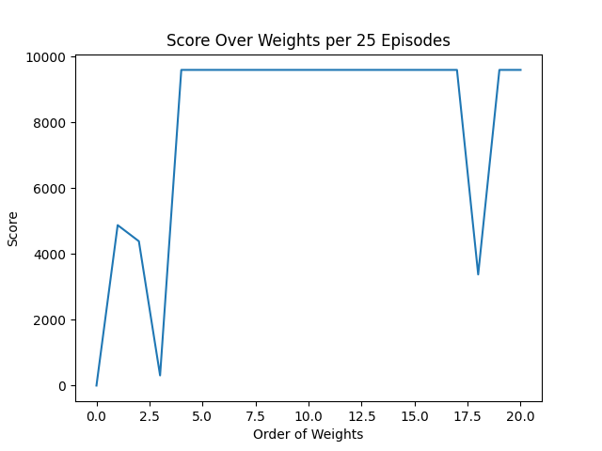
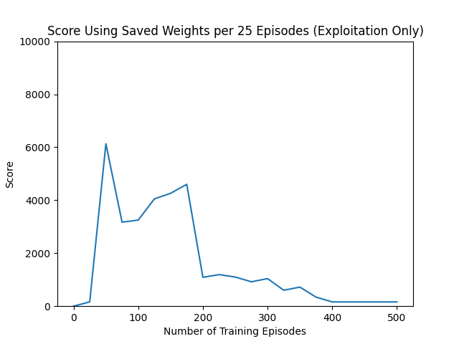
Version 3
Removed hard steps per episode limit
Added idle-steps per episode limit set to 4000
Improved DDQN performance with more consistency
Decreased DQN performance
DDQN:
DQN:

Slide 6
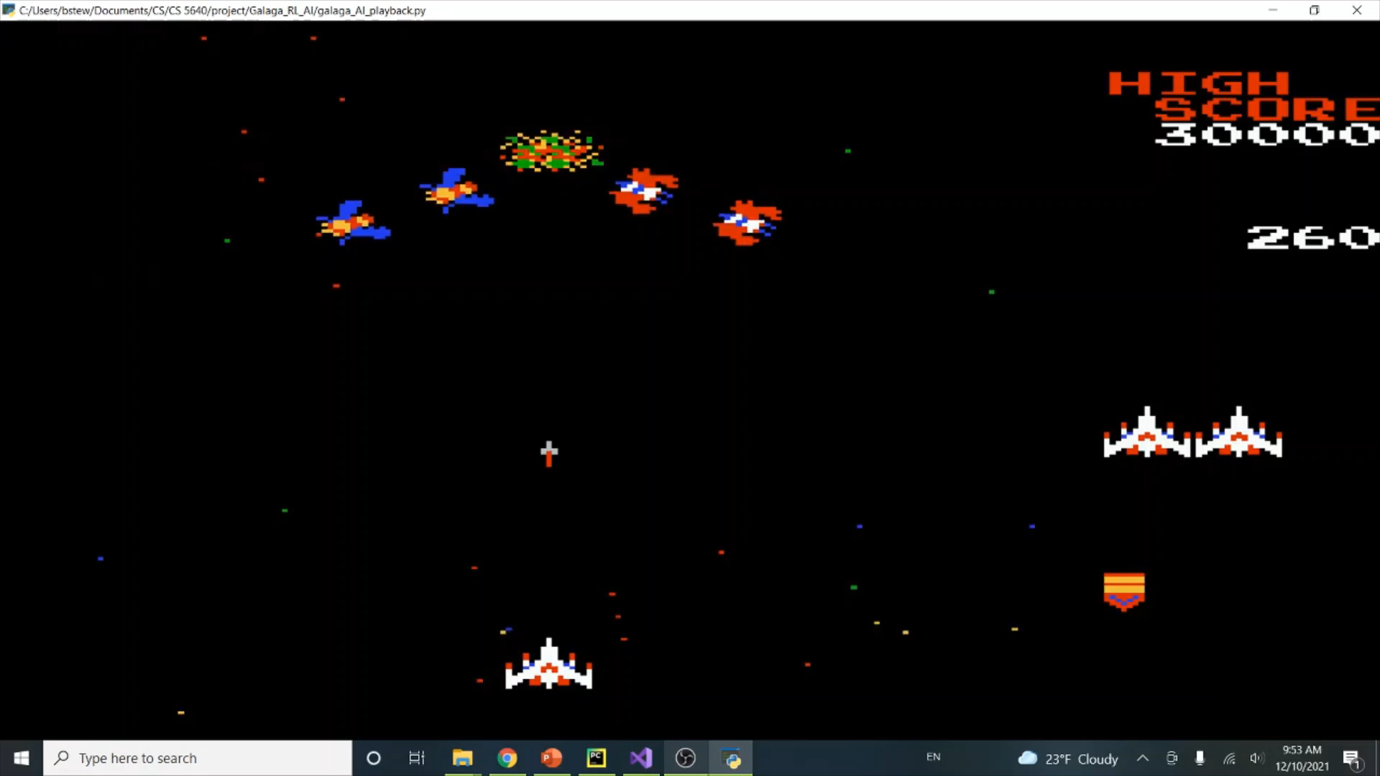
Demo of “Lazy” Strategy

Slide 7
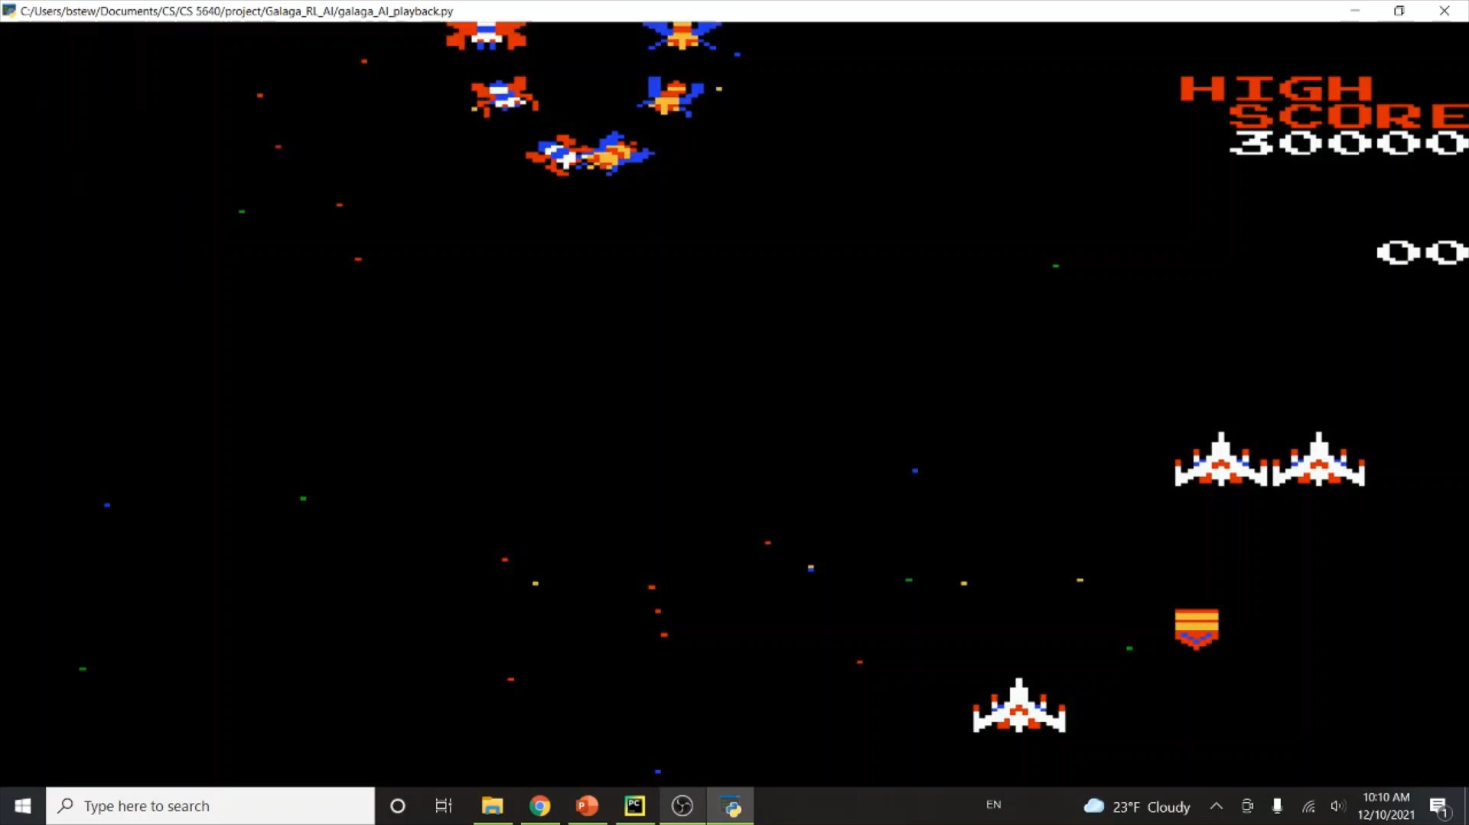
Demo of “Coward” Strategy

Slide 8
Summary & Conclusion
Altered and compared DDQN & DQN agents
Agents demonstrated a pattern of strategies
Results of learning were inconclusive
Neither agent had a decisive advantage over the other
Mother’s score remains safe, for now…

